Slide 1

Google Play Store
Dataset Analysis
Julia, Zayary, Davis, Kunal
Team #6
Notes:
3 min
5.15
7.45
9.45
10.3

Slide 2
01
02
TABLE OF CONTENTS
03
04
05
OUR DATASET
CHALLENGES
INSIGHTS
STRATEGIC VALUE
DATA EXPANSION

Slide 3
01
OUR
DATASET
The dataset we chose and our goals for what value to receive from it.

Slide 4
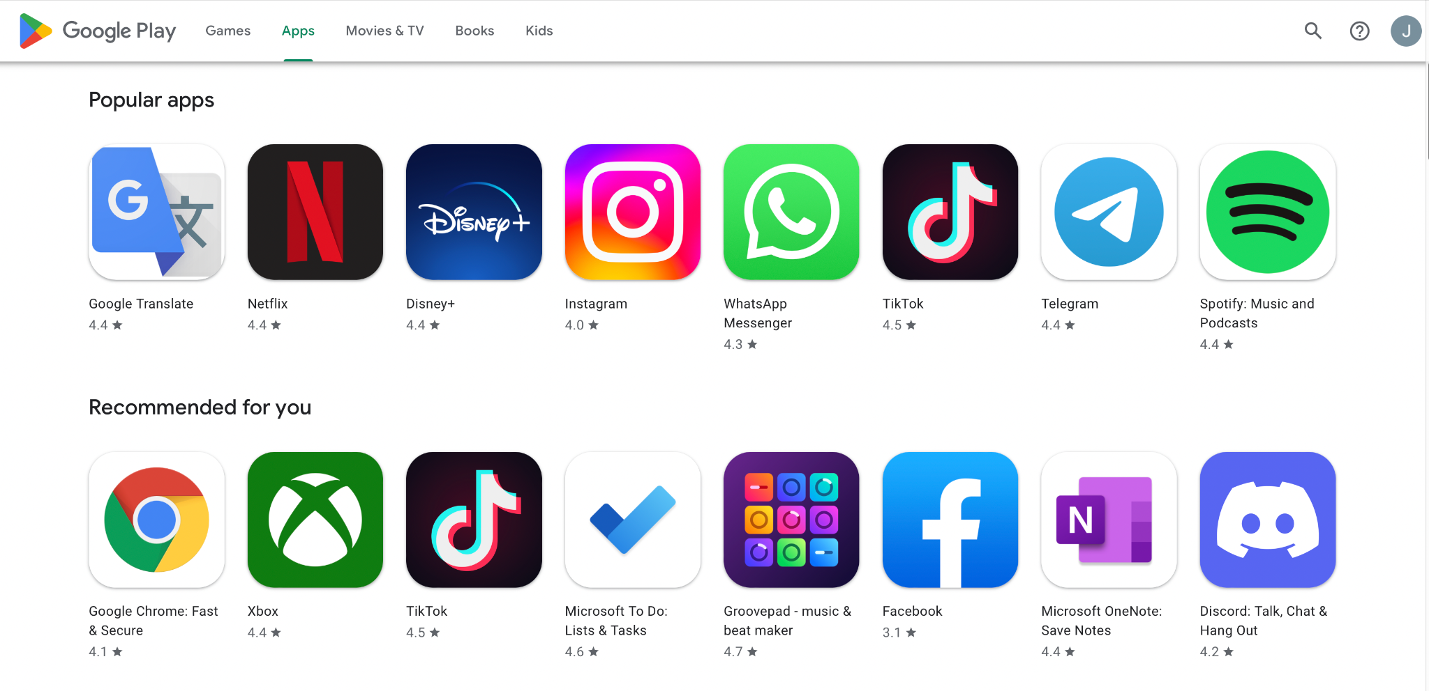
Dataset Description

Slide 5
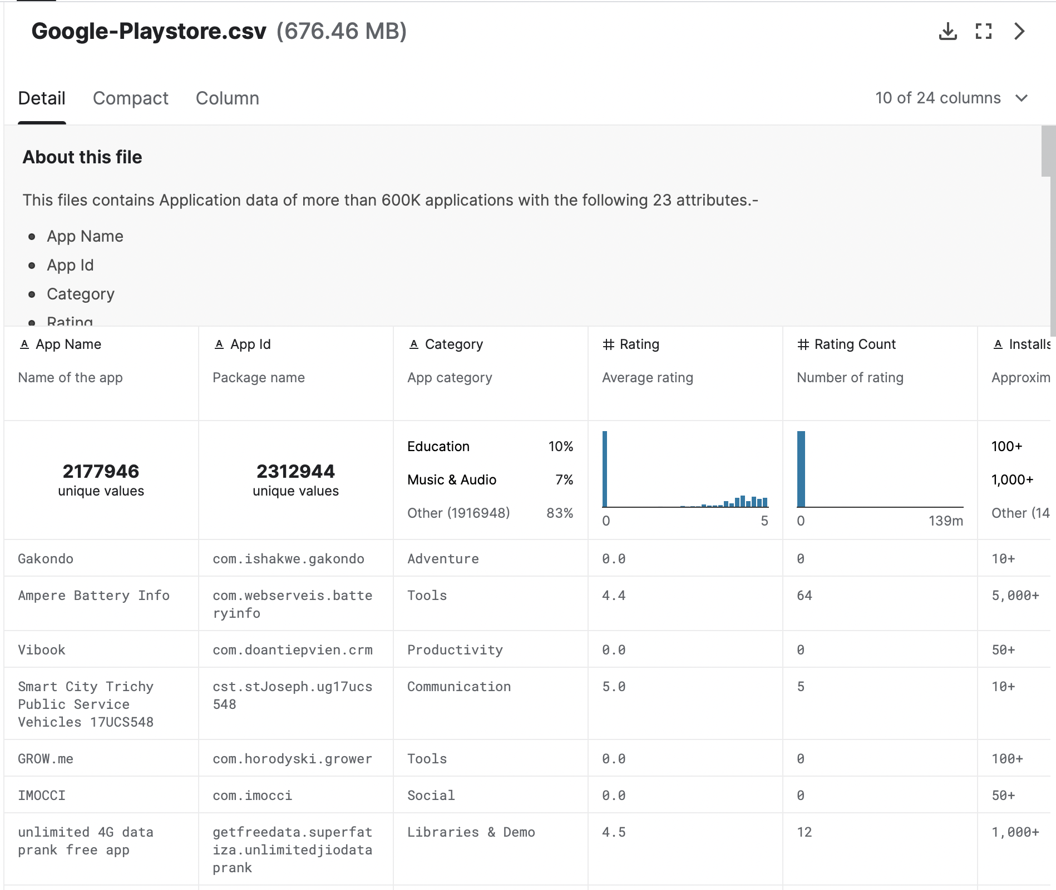
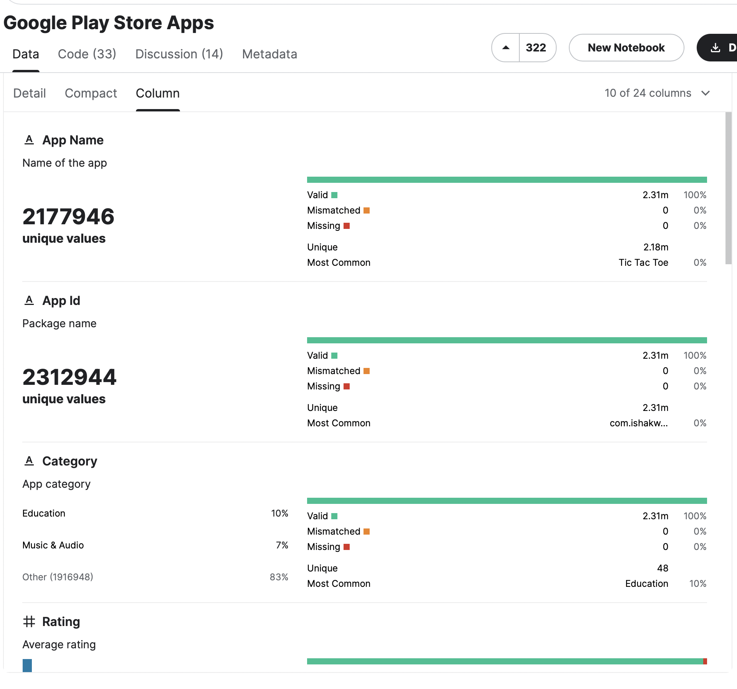
Details of the Data

Slide 6


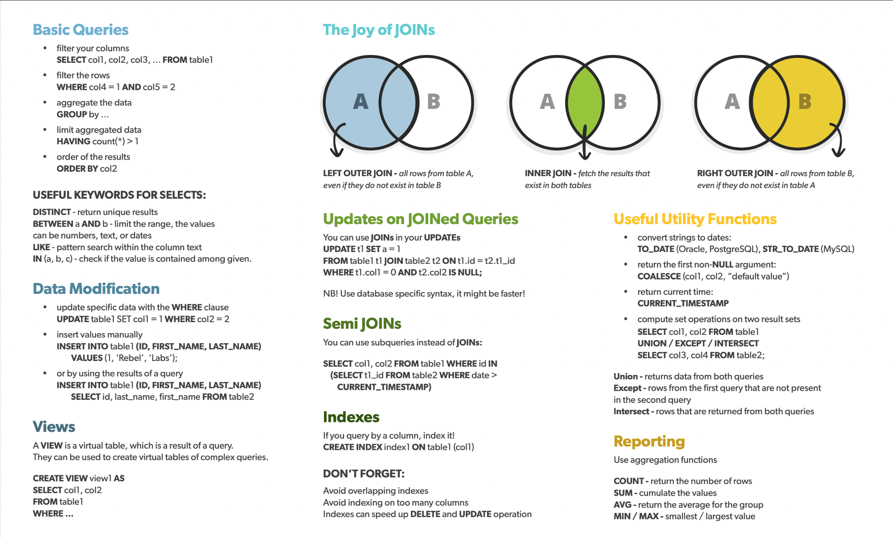
Tools and Approaches

Slide 7
02
CHALLENGES
The issues we ran into and how we overcame them.
Notes:
3.07

Slide 8
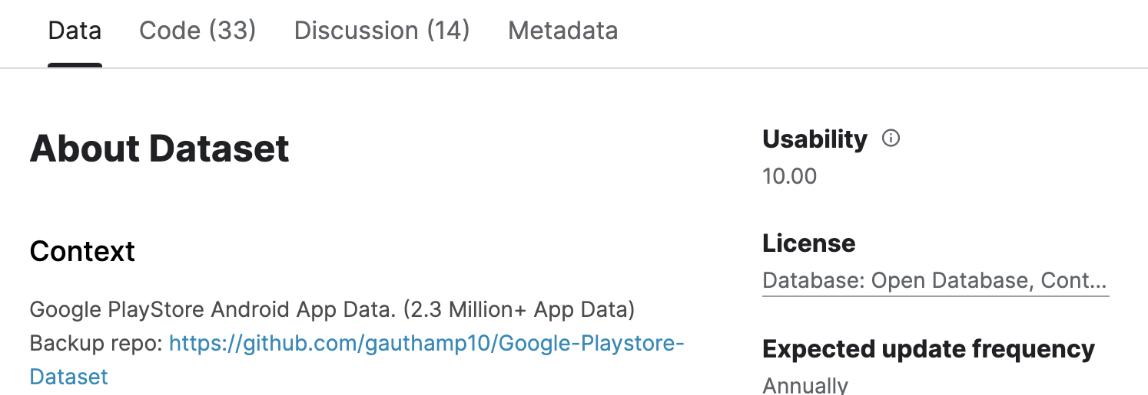
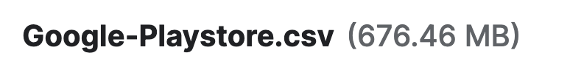


Data import
pandas
mysql.connector
RMariaDB
data.table
Notes:
3.07 talk about cleaning data

Slide 9
03
INSIGHTS
What information we pulled from the dataset.

Slide 10
Editors Choice Apps
.04%
79 mil
4.33
Editors Choice Apps
Average Installs
Average Ratings

Slide 11


Advertising via Apps
Apps with ads
Apps without ads
Average rating: 4.12
Average rating: 4.07
Average installs: 388k
Average installs: 252k
*with 50% of apps supporting ads

Slide 12
In App Purchases
In app
purchases
No in app purchases
Average rating: 4.08
Average rating: 4.11
Average installs: 1.5 mil
Average installs: 205k
*with 9% of apps having in app purchases
Notes:
5.13

Slide 13
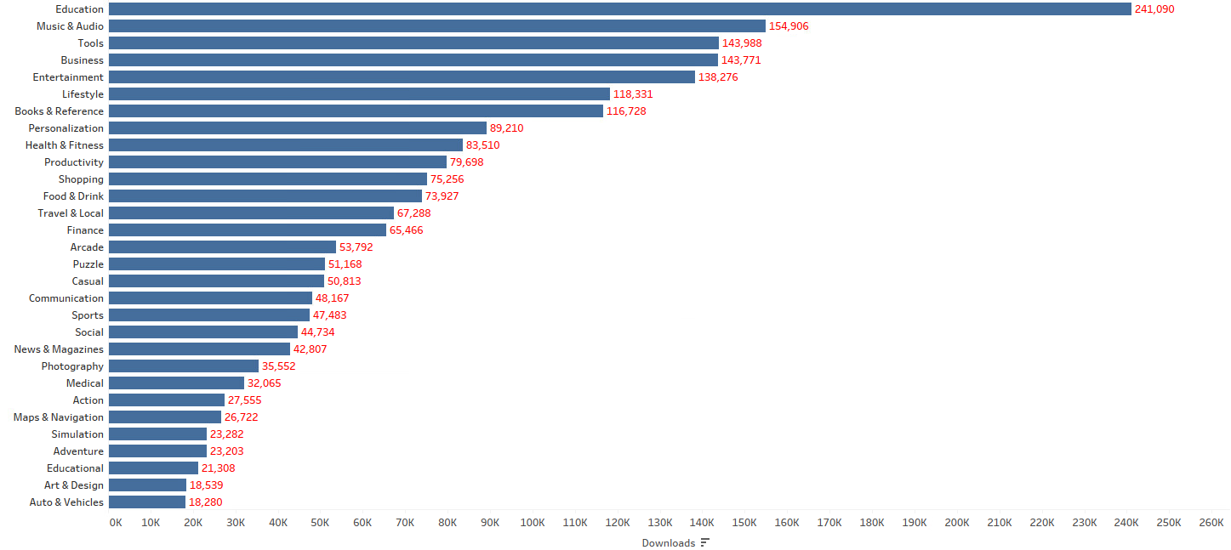
Total Apps by Category
55%
Applications

Slide 14
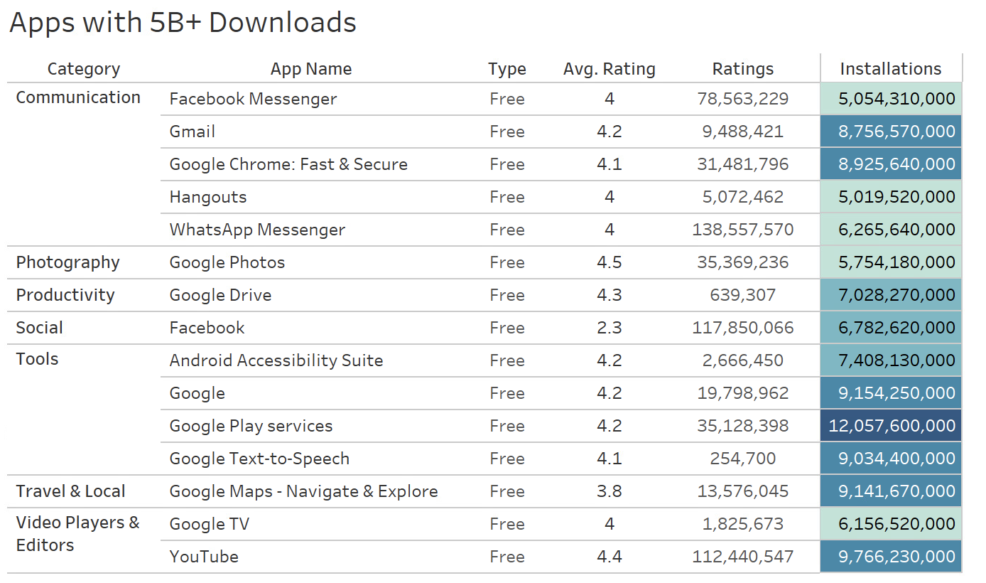
Most Downloaded Apps

Slide 15
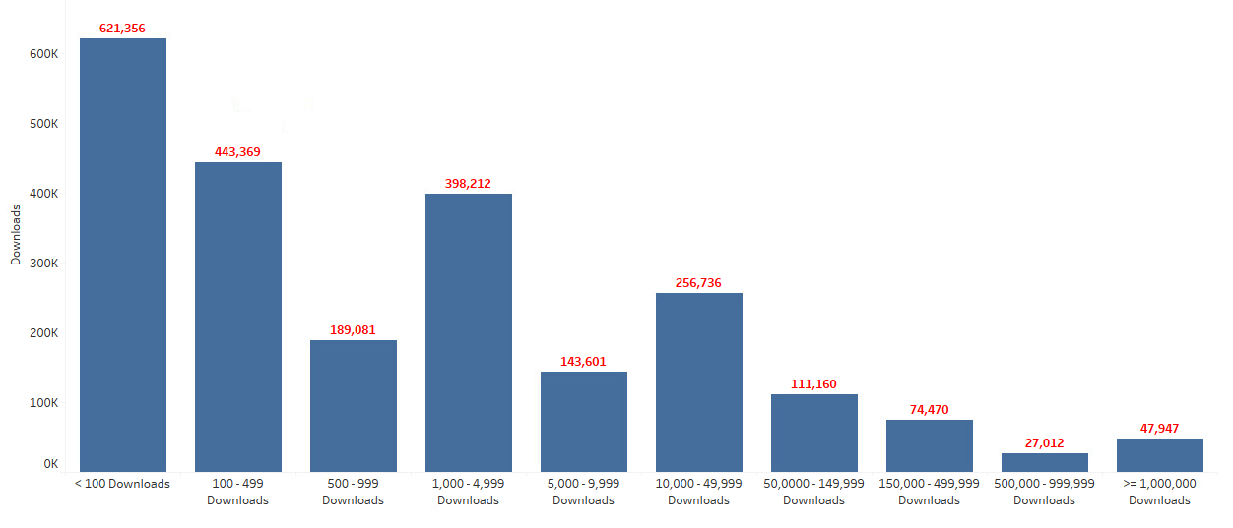
Distribution of Downloads
Applications

Slide 16
Installation and Rating
1,000
As low as 1
4.8
Apps
Lower Than Average Installs
Higher than Average Ratings
1,000
100,969,257
2.2
Apps
Higher Than Average Installs
Lower than Average Ratings
Notes:
Average Install 320k
Average rating 2.2
Average RatingCount 2865
7.45

Slide 17
04
STRATEGIC
VALUE
Who can benefit from our insights and how can it lead to better decision making.

Slide 18


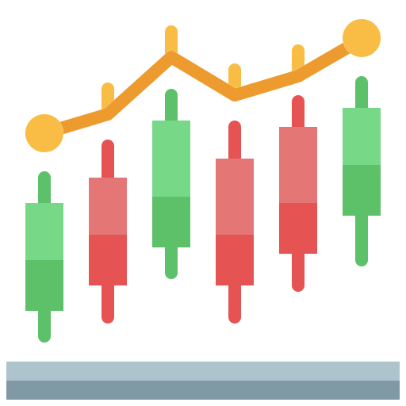
Valuable stakeholders
Developers who want to create an application
Companies that are looking to invest their money in applications that they would benefit from.
(Eg. Hospital chains acquiring an app for blood bank)
Users looking to invest their time in specific domains
(Eg. Stock Market)
Users looking for Apps in a new domain can refer this data to decide whether and which App to choose to download

Slide 19





Slide 20
05
DATA
EXPANSION
Missing data we wished we had and the next steps to take.

Slide 21
Common words or phrases in reviews
Are customers happy with the app?
Are customers facing any problems with the app?
How many in-app purchases were made
Which category makes the most revenue?
Where are users making the most purchases?
Country specific data
How should we allocate our marketing budget?
Does one ad fit all countries?
Size of the developer
Are big developers more successful?
Do big developers own most of the apps available?
Notes:
10.15

Slide 22
THANK YOU!
We’d love to answer any questions you have.

Slide 23
Appendix
#Number of apps in each category
SELECT
Category,
COUNT(*) as Count
FROM Google.Playstore
GROUP BY Category;
#Download Distribution
SELECT
sum(maximuminstalls < 100) as '< 100 Downloads',
sum(maximuminstalls between 100 and 499) as '100 - 499 Downloads',
sum(maximuminstalls between 500 and 999) as '500 - 999 Downloads',
sum(maximuminstalls between 1000 and 4999) as '1,000 - 4,999 Downloads',
sum(maximuminstalls between 5000 and 9999) as '5,000 - 9,999 Downloads',
sum(maximuminstalls between 10000 and 49999) as '10,000 - 49,999 Downloads',
sum(maximuminstalls between 50000 and 149999) as '50,0000 - 149,999 Downloads',
sum(maximuminstalls between 150000 and 499999) as '150,000 - 499,999 Downloads',
sum(maximuminstalls between 500000 and 999999) as '500,000 - 999,999 Downloads',
sum(maximuminstalls >= 1000000) as '>= 1,000,000 Downloads'
FROM Google.Playstore;
# 5B+ Downloads
SELECT
category,
AppName,
Free,
Rating,
RatingCount,
MaximumInstalls
FROM Google.Playstore
WHERE MaximumInstalls > 5000000000

Slide 24
Appendix
#Highest and Lowest Categorical downloads
Highest:
select
category, sum(MaximumInstalls)
from
googleplaystore
group by
category
order by
sum(MaximumInstalls) desc
limit 1;
Lowest:
select
category, sum(MaximumInstalls)
from
googleplaystore
group by
category
order by
sum(MaximumInstalls) asc
limit 1;
#which apps have the 5 topmost ratings
select
appname
from googleplaystore as b
inner join
(select
distinct rating as rating_app
from
googleplaystore
order by
rating_app desc
limit 5) as a on a.rating_app = b.rating;
Which developers developed the top 5 APPs that had the highest installation rate
select
AppName
from
googleplaystore
order by
MaximumInstalls desc
limit 5;
#Apps that have lower than average Rating yet Higher than average Installs
select AppName, Rating, MaximumInstalls
from s1.GooglePlaystore
where Rating<(select avg(Rating) from s1.GooglePlaystore)
and MaximumInstalls>(select avg(MaximumInstalls) from s1.GooglePlaystore)
order by MaximumInstalls DESC;

Slide 25
Appendix
#what percentage of apps have in app purchases?
select sum(InAppPurchases) / count(*)
from GooglePlaystore;
#result: 8.44%
#average ratings for apps with in app purchases
select avg(Rating)
from GooglePlaystore
where InAppPurchases = 1 and RatingCount > 0;
#result: 4.08 stars
#average ratings for apps without in app purchases
select avg(Rating)
from GooglePlaystore
where InAppPurchases = 0 and RatingCount > 0;
#result: 4.11 stars
#average installs for apps with in app purchases
select avg(MaximumInstalls)
from GooglePlaystore
where InAppPurchases = 1;
#result: 1,569,007.94 installs
#average installs for apps without in app purchases
select avg(MaximumInstalls)
from GooglePlaystore
where InAppPurchases = 0;
#result: 205,025 installs
#what percentage of apps have 0 rating count?
select (select count(RatingCount)
from GooglePlaystore
where RatingCount = 0) / count(*)
from GooglePlaystore;
#result: 45.82% have no ratings
SELECT * FROM google_play_store.GooglePlaystore;
#percentage of editors choice?
select sum(EditorsChoice) / count(*)
from GooglePlaystore;
#result: less than .04%
#average installs for 'editors choice apps'
select avg(MaximumInstalls)
from GooglePlaystore
where EditorsChoice = 1;
#result: 79,058,974.24 installs
#average installs for apps with ads supported
select avg(MaximumInstalls)
from GooglePlaystore
where AdSupported = 1;
#result: 388,416.30 installs
#average installs for apps without ads supported
select avg(MaximumInstalls)
from GooglePlaystore
where AdSupported = 0;
#result: 252,656.03 installs
#how many apps have both ads supported and in app purchases?
select count(AppName)
from GooglePlaystore
where AdSupported = 1 and InAppPurchases = 1;
#result: 141,648
#what percentage of apps support ads?
select sum(AdSupported) / count(*)
from GooglePlaystore;
#result: 49.75%
#average ratings for 'editors choice apps'
select avg(Rating)
from GooglePlaystore
where EditorsChoice = 1 and RatingCount > 0;
#result: 4.33 stars
#average ratings for apps with ads supported
select avg(Rating)
from GooglePlaystore
where AdSupported = 1 and RatingCount > 0;
#result: 4.12 stars
#average ratings for apps without ads supported
select avg(Rating)
from GooglePlaystore
where AdSupported = 0 and RatingCount > 0;
#result: 4.07 stars

